Slide 1
HACKATHON
DISPLAY ALL THE SPORTS ACTIVITIES AVAILABLE IN YOUR CITY FOR COMING WEEKEND
Group VI -AMIGOS
Naveen Kumar Sakthivel- 890111
Naveen Kumar Sathiamurthi- 890347
Janaranjani Muruganadham-890110
Meena Kulanthaivel– 890112
Venkat Teja Bogsingirigari-889728

Slide 2
Project Description
Find the sports activities in your city for coming weekend, display the name of the sports.
Extract all the languages for movies and store in a List; Display the same.
Try to 'Sign In' with google, give invalid account details & capture the error message(Suggested Site: bookmyshow.com however you are free to use any other legitimate site) (Used Site:- bookmyshow.com).

Slide 3
Tools
Eclipse IDE
TestNG
Maven
Jenkins

Slide 4
First Description
Find the sports activities in your city for coming weekend, display the name of the sports and store it on the list and
And display the names.

Slide 5
Bookmyshow Site should be opened.
On clicking on sports activities, the events will display on that page.
Sort the events for this weekend.
Store those events’ title into a list and display the list.

Slide 6
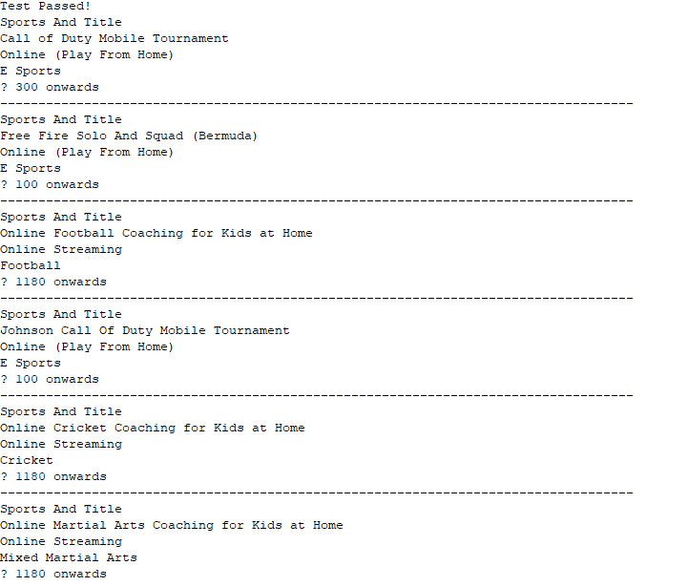
Titles Of The Sports Events

Slide 7
Second Description Select the Movies and get all the Languages on that page.
Bookmyshow Site should be opened.
On clicking on movies activities, the movies will display on that page.
On the top of the page the languages of the movies are displayed.
Store those languages into a list and display the language.

Slide 8

List Of Languages

Slide 9
Third Description
Try to 'Sign In' with google, give invalid account details & capture the error message.
Click on sign in button
Login with google
Set invalid account details
Capture the error message

Slide 10
Captured Error Message

Slide 11
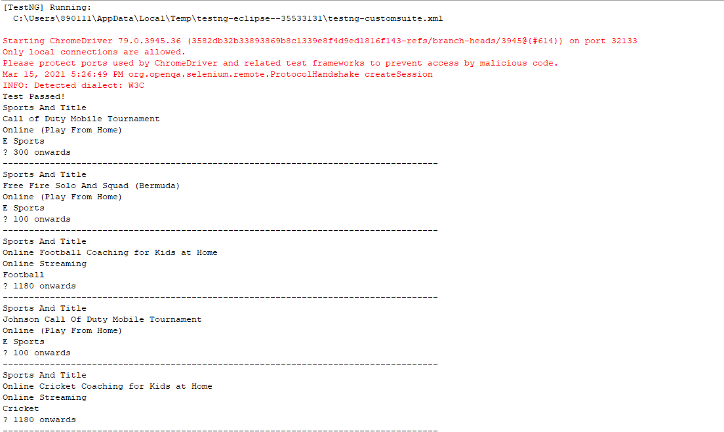
Eclipse Console

Slide 12
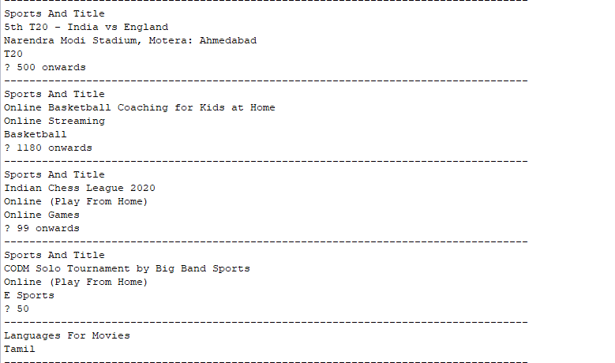

Slide 13
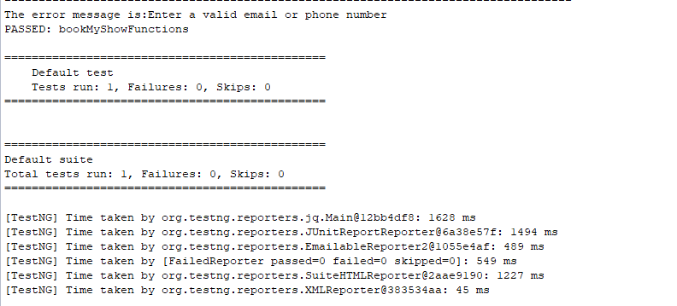

Slide 14
Thank you…

